Slide 1
Notes:
Cheater notes )infill spots:
Chalk board /3 bows forward and one bow to audience

Slide 2
Notes:
Cheater notes:
thank everyone being here -Ask who’s new today? Welcome! BTW, this is your lecture to welcome interceptions, interruption of conversations hand raise or not as this is a safe place for surprised wisdom to occur. Stop me anytime. Not to lecture or draw conclusions but create an opening behind an opening. Tao is nameless, un-carved block G_D (Tao’s water metaphor)
My physical introduction into Tao; Tao is water course ways offering a fluid wisdom. Through drowning at 2 Year old/latter fear at pool edge/surfing 20 foot waves and night surfing alone past the fearof Tao –watching the oceans behavior, night surfing, Feeling fearless in powers of Tao, the watery ways and timing with nature of water. Innocently realizing there is no fear as excitement takes over fear as drowning to surfing. Surfing energy moments

Slide 3
Accidental Wisdom to Unlocking the Tao
Follow Knowing Without Reason
By John Salat Copyright © 2012 John Salat, All rights reserved.
Notes:
Tao means to me Life. So it is being in life without ego. We are not cheapening life as accidents, or coincidence into the kwinkey dinkey’s, but suspending ego for awhile just to have fun today to release the guarded ego.
When we Give up reasons to live our life, life shows us how to live.
Footnote: watch screen and hit it each time-don’t look at paper

Slide 4
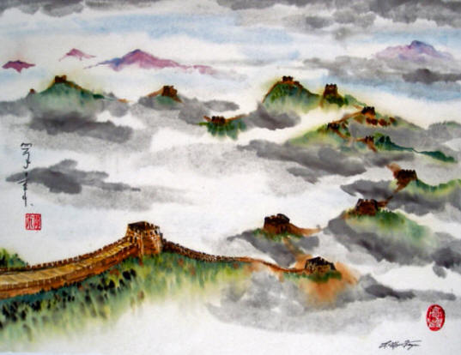
Is wisdom really following fresh creativity and not facts?
We may see boredom follow us, yet when serendipity kicks-in, suddenly magic appears. What we notice when tapping the source from the unplanned of beyond reason, we become the agents of flow.
In this freedom, justification no longer has root. Instead, life richly pours new dimensions of intimate experiences…
…Lets explore what this is.
Notes:
1) Through photos, you can see Albert Einstein was a dreamer using imagination, trancing and transcending different worlds. Albert Einstein said. "Imagination is more important than knowledge”. He further expands that into saying “He who no longer pause to wonder and stand rapt in awe, is good as dead; his eyes are closed." If you are board, then you are not curious. Possibilities only come from being curious. Today, lets take a journey together and boldly go where you never gone before.
3) Distinctions are not the truth ,it is a pointless tool to help us get out of our head and into intimacy of heartfelt magic.

Slide 5
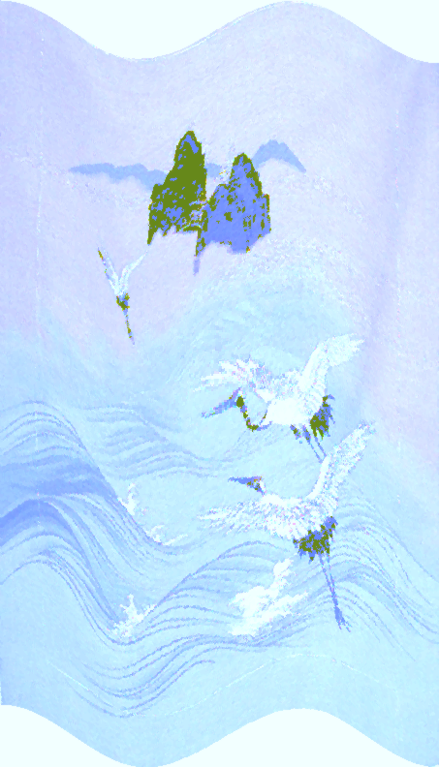
“Accidental” usually defines to “unexpectedly or unintentionally.” However, in this discussion, “accident” refers to sustaining rest from ego.
This minds-off approach offers life a chance for things to happen outside to what we typically know.
With accidents, we either share our good fortunes, or hesitate revealing our misfortunes. This is because our ego has a latent response of not quite matching-up incidents and instead justifies with “What just happen? ” or “Why did it happen ? ”
Notes:
3) From denial or pain to moments. Comedians, artist and other creative people pull things out-from-the-sky using moments and experience in linking to these spontaneous dimensions. Rather than holding on they mock there own ego.
Using spontaneous felt moments for a sense of release to transmute pain from a serious events into laughter. Remember to laugh. Can you laugh at your own incompetence? Do you see the absurdities from your often thought of serious circumstances?
Transmuting pain into a new realm of peace.

Slide 6
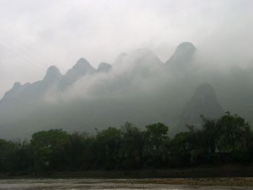
Rather holding accidents as haphazard of lost control, let’s adapt these moments as excitement of embracing spontaneity.
Supposed if we could align our life events as “perfect incidents of revered moments”, then we may live the experience of Tao.
Admiration endures “what’s so” and differentiating “what’s not” in honoring “what is.”
Have you ever argue saying, “This shouldn't be!”
Notes:
4) I know I argues with life events or circumstances that follow me everyday. Whatever life scoops up, let’s look how we can embrace life’s accidents warmly through this living wisdom with the Tao”. As being it shouldn’t be loses power a steam for life excitement

Slide 7
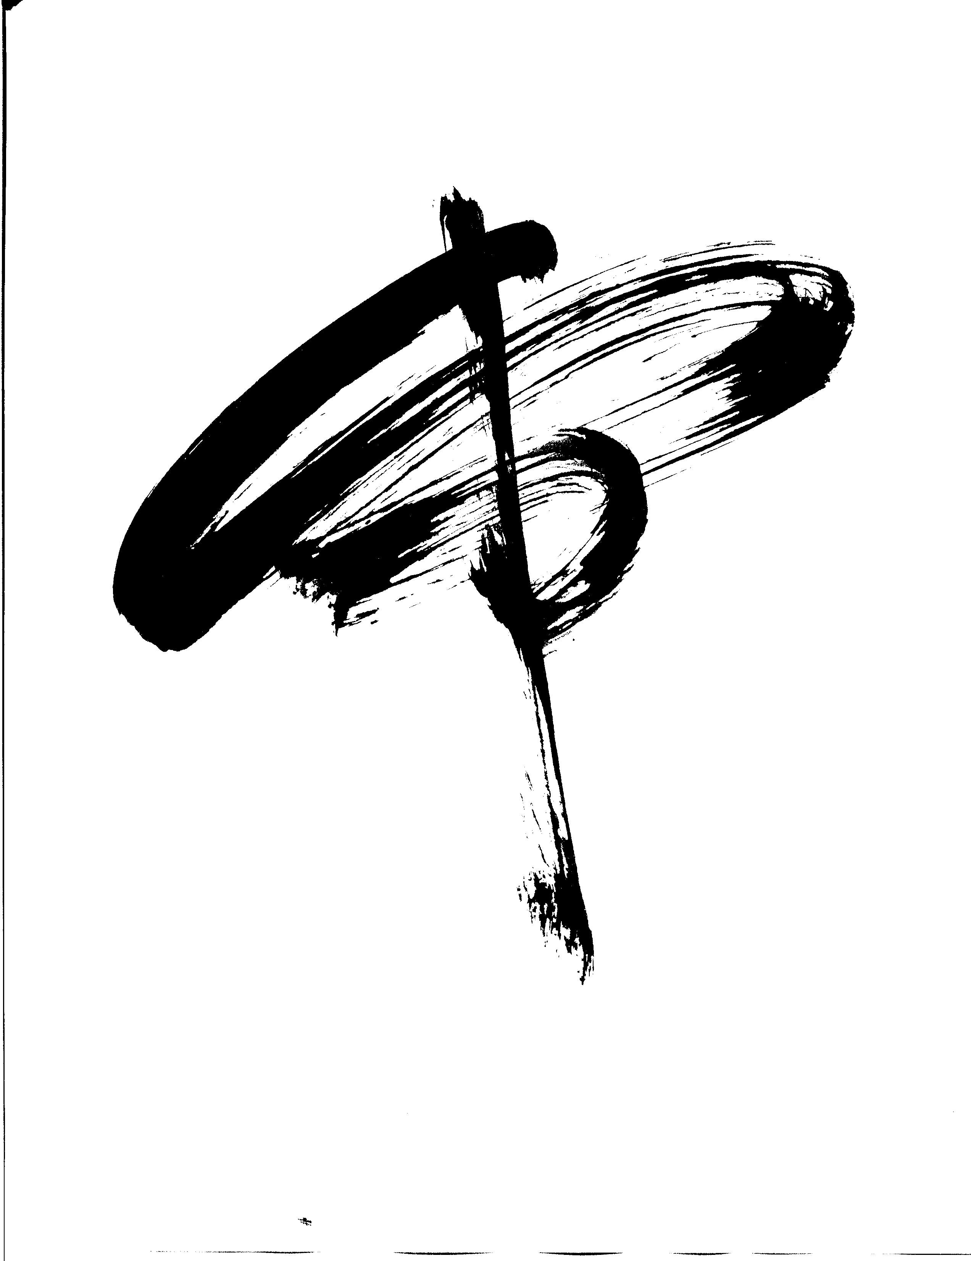
Having breakthroughs occurs outside familiarity and into new realms of unfamiliarity. This is where real-time wisdom is aroused, creating those “Aha” moments.
The awakening to this knowledge starts from in moments noticing when I “I don’t know that I don’t know” as a breaking ground to fresh wisdom.
Not only do these keys of unknowing humbly provokes power to birth knowledge, it empties our mind to land deeper in the heart.
Notes:
I hope you enjoy the black and white photos of sumi paintings as my works
Often relate as the term “New weird normal”, a new paradigm to rinsing the mind. Reset mode
gravity of thoughts relaxing from our head and down spilling into the hearts

Slide 8
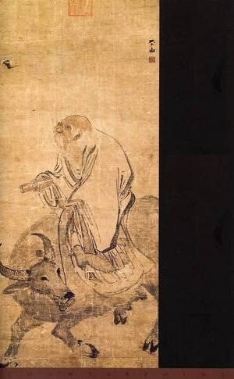
Essentially, the birth of knowledge has no reason. In fact, when we give up reasons to live our life, life shows us how to live.
These mindless states of emptying ourselves sustains “Mindlessness” or, “Non-mind.” This consciousness engages boundless wisdom to our surfing moments…. celebrating “being-ness.”
Although having the absence of words and meaning offers no measurement, it does suspend thoughts temporary without holding conclusion, yet reserves fresh reference. Therefore, meaningless and pointlessness sources true knowledge.
Notes:
2) Ontology is study of beingness and its nature with all existence. Avatar is mastering or having peaks of beingness. Human awareness operating from the state of natural existence in a world consciousness through an internal understanding. Living examples: granting being, fulfilling being-ness, the way of being, etc.
3) Tai chi is a physical experience to empty oneself so fill up ourselves innocently with something else that is us. To empty is creating fullness

Slide 9
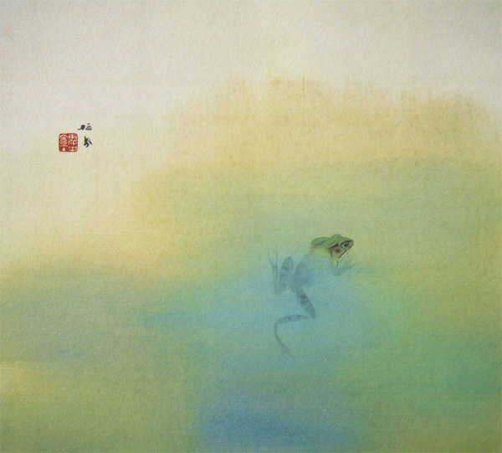
Both “Knowing” and “not knowing” usually draws criticisms and sometimes consequences carried by most cultures; Walking this tight rope causes high expectation and poor performance. Yet, how do we arrive to a innocent place of knowledge that touches the Tao Wisdom?
Let’s go deeper to review the myths that destroy our intrinsic knowing.
First, we are already connected to this wisdom, yet somehow in our course of life we conveniently found a turn-off switch to separate the “Whole Perfect and Complete” states of being. Surprisingly, we are both consciously and unconsciously creating a stream of abundant wisdom.
Notice “Unconsciously” is included as a “slip” word so the ego will not over-strain seeking right answers.
Notes:
1) Any one relates to this in there life?
1) In my profession, confidence is smelled out quickly, yet the ego can sometimes interferes with my own nature. In confidence of knowing, not knowing dances in my architect practice, managing 30 million dollar jobs requires the utmost awareness, as an architects, architect the image of being faultless image scares me ,… well as I thought but really people respect being my true nature. Vulnerability is power, not weakness as long as my ego does not grab me.

Slide 10
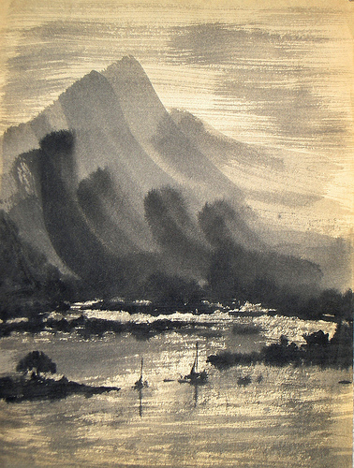
The conscious-self is already aware of itself as all we need is to release all the duality about it looking right or wrong and instead own relaxed responsiveness. If we do not step back, then we will be standing, waiting while pretending we don’t know.
If the balance of “knowing” and “not knowing” is the relaxed wisdom then we can be with “knowing” and “not knowing” of awareness, both the same time.
Although some people hate to be wrong or like to be right, others may have no attachment to either.
Yet rising from the empty and meaningless states brings genuine wisdom, as we give way to either side from attachment.
Notes:
1) A paradox :DAH!! I pretend I don’t know to escape responsibility but not confused as soft not knowing as that is melting into the moment in vulnerability states (Open minded skeptic deserves more honor than total gullibility). Its to boring to assume and challenge or enquiry experiences.
4) The terms “hollow,” “empty” and “meaningless” does not mean “it doesn’t matter,” because we still have responsible actions that groove deeply from our life purpose. However, look at the meaning-making machine of matters and its context your mind holds with them. (Less ego) More deeper than that , its empty the head and landing into the heart.

Slide 11
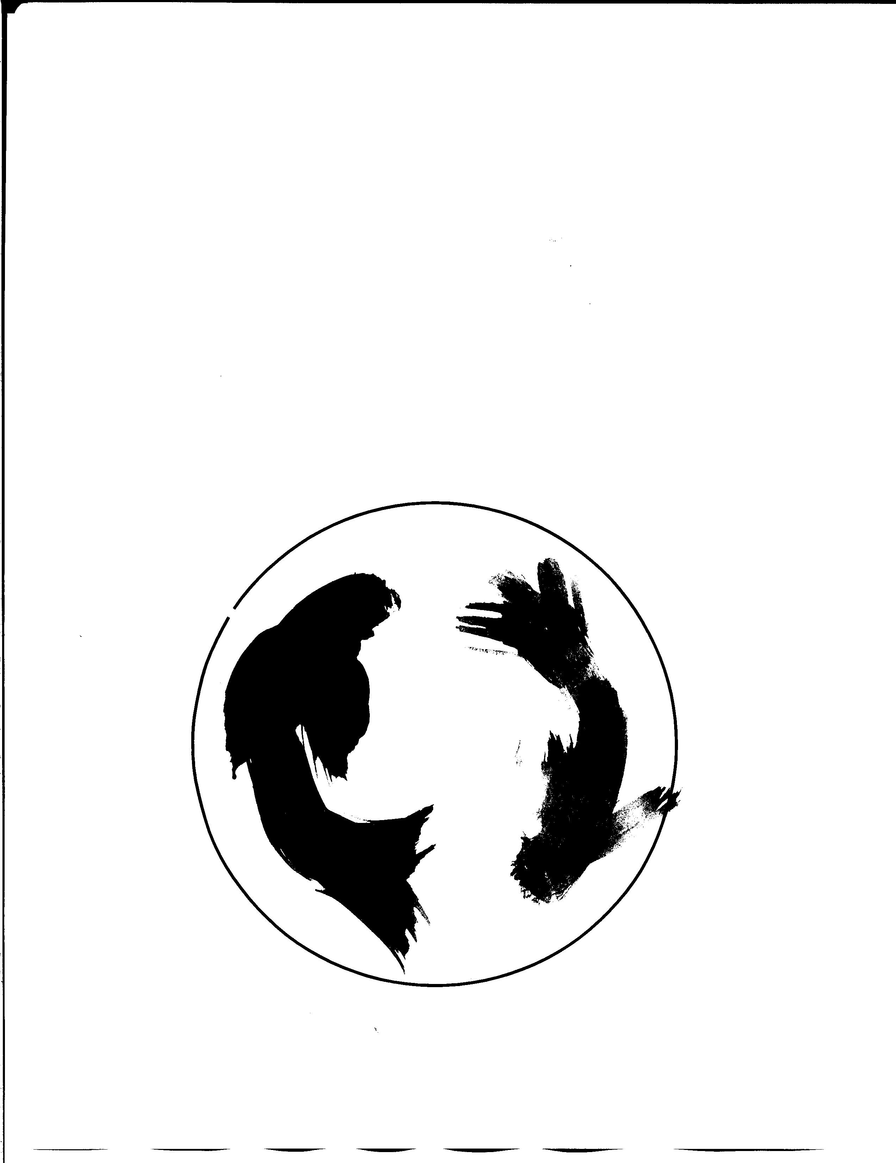
In uncovering these virtues, let’s view some examples of how wisdom can be embraced.
The components of Yin and Yang is relaxing with “What I know” (Yang) and “What I don’t know” (Yin). This sense of insight expresses simple essence of knowledge just as the air we breathe.
That means balancing of “knowing” and “not knowing” complements a sense of self through relaxed wisdom.
Notes:
3) Slow down and let them ask questions; Less energy attachment to the poles draws peace. We can celebrate life without waiting to being totally polished, because fun mostly occurs during our polishing moments.

Slide 12
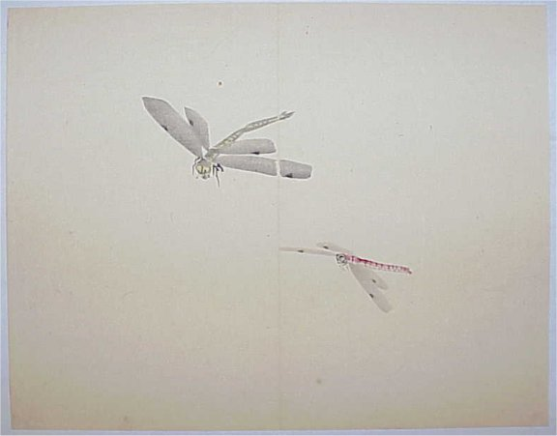
Without attachment to these opposite poles of awareness, let’s reset this awareness into empty meaningless states. We can merge fresh consciousness constructively by hypnotizing ourselves just for a moment to create new control.
An example; Lets start from nature
If a dragonfly passes by, it may feel as if consciousness had momentarily blinked from the buzzing sounds that surround you. Briefly in those moments, one’s awareness becomes offset with both grounded and ungrounded moments as the fluctuating wings of the insect “bounces-in to out “ from two worlds simultaneously.
Notes:
Some examples of bridging two words of knowing is day dreaming, blackout states, or even falling into half-awake / half-asleep trance of awareness. As allusive this may all sound these organic expressions sits idle inside us, because wisdom already waits for us to draw from them.
Let me paint a further picture being in transcending states with nature; We seen all been serenade by the sounds of ocean waves or see the sun bouncing off the glistening top of water or perhaps in mountains winds blowing through leaves with whooshing sounds and a stunning sparkle rays of light. Does everyone relate to going into a trance like moment with nature of forgetting who they are.
In visiting places of Nature we become the nature watching as we turn ourselves inside out and blossoming a we collapse to the moment with a command to listen with our surreal experience a contemplative moment.

Slide 13
The metaphor of dragonfly’s sounds replicates this wisdom as fluctuating awareness, bridging “knowing with not knowing.”
Accidental wisdom yields to these fluctuations into authentic living through these dimensions. The twin states of this awareness is like sticking one foot in water and one foot out of the water. This illusive state gives the ego a rest without a chance to interact or take guard.
This means we could embrace both levels of consciousness as vital connections for wisdom, bringing no attachment to thoughts or actions through our daily living.
Notes:
3) Early eastern sages connect to underworlds simultaneously to connect to this divine wisdom

Slide 14
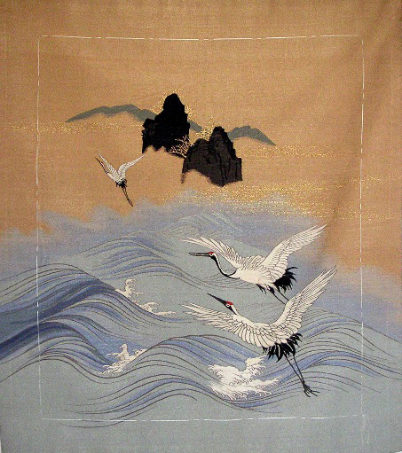
This freedom of organic knowing releases the ego. Ideally, we like to think the dissolved ego eventually comes quietly to rest, however the ego is unlikely to ever disappear, so cultivation is still necessary.
Cultivation intimately works from “uncharted knowledge.” Westerners call this in practice “blind faith” while Easterners dwell in “trusting the darkly nowhere.”
From either definition, this wisdom organically flows innocently through reaching these natural states. This knowing further expresses by the term “Wu Ji”; meaning “Supreme Unknown.” A peak to touching the “Summit to Great Nothingness” of limitless knowing.
Notes:
Subtle awareness states being vulnerable during lost, grief and pain, the shell cracks open for states mapping to uncharted wells of wisdom

Slide 15
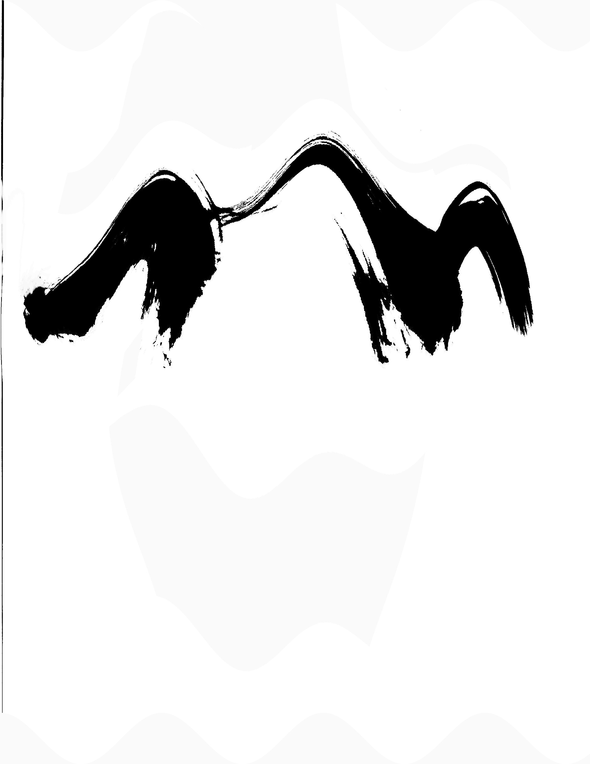
Tea Break
Calling Closer to Awareness
On an organic level, pay attention when your energy of aliveness as either boosted or deflated.
To fine-tune your presence, can you find a sweet spot to choice-making? Don’t write it down, just feel it through your day and make a light note to yourself while having these moments.
Allow experiences to navigate your ways that keeps yourself fresh with this awareness. By simply choosing the most passionate action, this new attention will authentically draw you to a powerful day.

Slide 16

By giving up our formal rights “to know” opens reverence to new moments of free flow knowledge.
Through mindfulness, keeping the “in-check” and “in- flow” of our awareness creates opportune moments. Without reason or understanding, we can be unattached to concerns so freeing moments may elusively rise on its own.
Soft curiosity can further take us there, like open sails gently being pulled by winds. This fresh air of knowledge is like the wind, arriving nowhere, yet is everywhere.
Notes:
3) Notice this language speaks softly as feminine side of response of activity. Rather being soft I sometimes find myself get anxious where fear brings pushiness through control myself or with others. How else do you often find yourself trying to motivate yourself or others using control mediums of rewards/punishment (Either discipline is like Punishing to ”giving poison” and “rewards” is like throwing a bone) or, are you simply using intrinsic natural motivators? Freed of self-will, self-choice

Slide 17
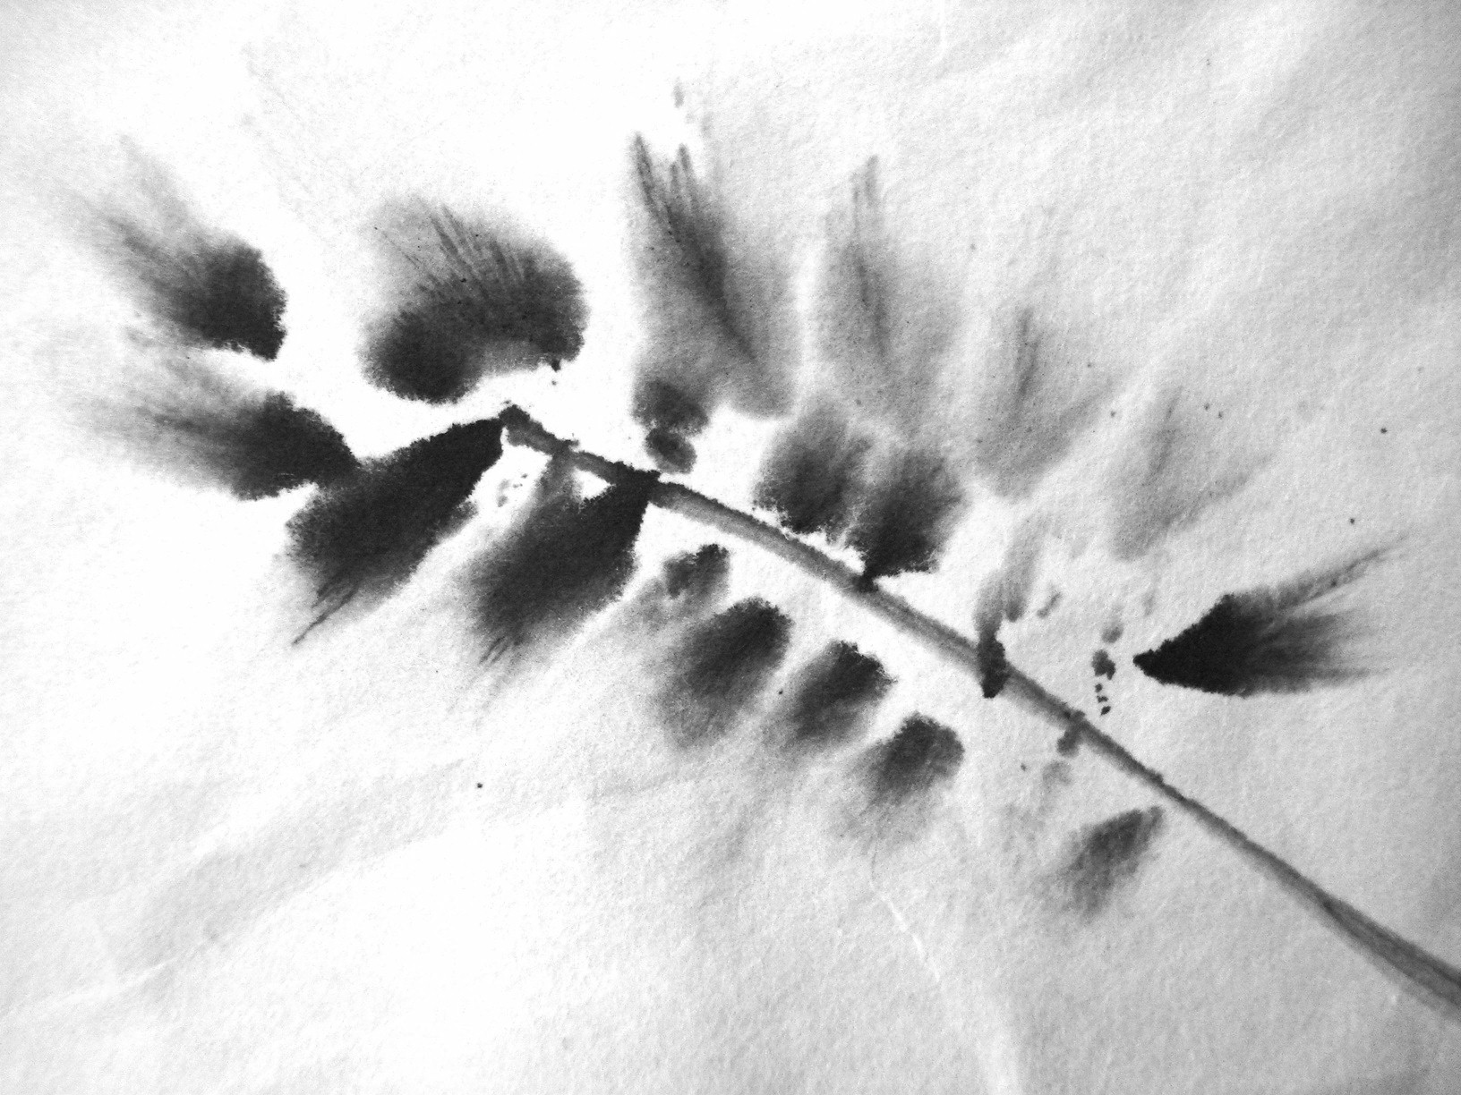
Open Pause (Further Inquiry )
Can you master “knowing-ness” with “not knowing” as a bridge of surfacing powerful moments?
As conflicting this might sound, what would your life be like if you were comfortable standing in uncertainty? What are the considerations, risk or awe?
Do you see as you suspend inside uncertainly that a bridge to real faith draws alchemy to super consciousness?
Notes:
Interacting with group there take- example is street gangs use fear
How powerful would life be suspending yourself in awe?

Slide 18
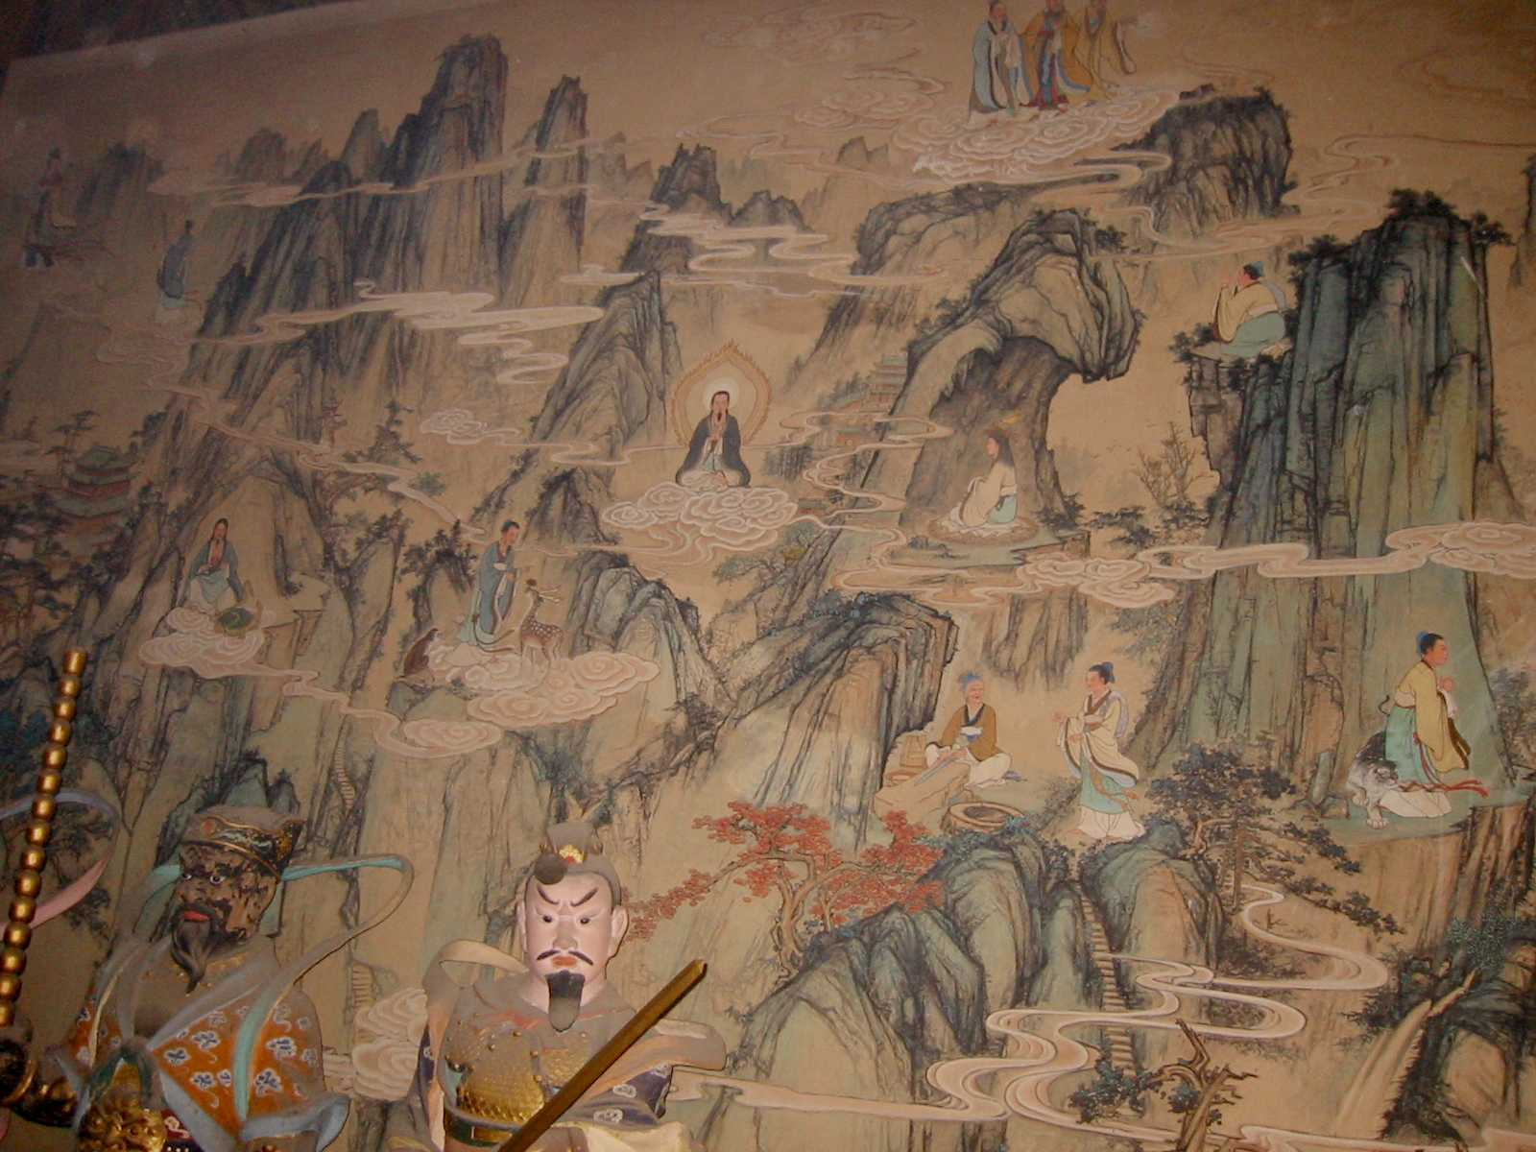
In the continual process of letting go of our familiar controls, a new control takes charge beyond comprehension. This knowing relaxes beyond all restrictions of thoughts or actions.
Is it easy to see different results when we relax and unlock the ego because a new transparency appears?
But first, how do we know the egos engaged?
- serious emotions start setting-in
- weighted thoughts start taking over
- finding ourselves re-hatching the past/future
Notes:
1) Any body relate to The ego cyclically keeps asking questions about the questions?
3) It is when serious emotions start setting-in. These heavy sensations followed by weighted thoughts are clues. Seriousness not only impacts ourselves and others as nothing happens alone . If I am not in my own impacts of who I am being then I get to see the impacts if others to who I am being., This usually cleans up my act noticing how it lands with others

Slide 19

Exploring “soft knowledge” is allowing a forgiving system to enter through the streams of our awareness and feed us wisdom. This Ebb and Flow of our awareness favorably breakthroughs when we just allow fun to be.
If we abandon our punctual concerns and instead play resistance with consciousness, then witnessing this interaction dissolves ego. Separating from the mundane, adding ingredients of mischief will further help disrupt the status-quo.
Offer a playful twist of this medicine furthers interrogate the ego into “selfless acts.” The good news is these moments leaves nothing with us except rich and whole experiences.
Notes:
Am I loosing anyone- movinfgtoo fast -I watched to many kung fu movies with grasshopper deep thoughts.

Slide 20
Ego Freeing Exercise
If everything else fails in attempts to releasing the ego, let’s offer a fun mantra to verbalize syllable sounds.
Try saying several times, happily-rapidly: “Budd-ha,” “Budd-ha,” “Budd-ha,” “Budd-ha,” “Budd-ha,” to lighten the air around you. This time with more fun, again, “Budd-ha,” “Budd-ha,” “Budd-ha,” “Budd-ha,” “Budd-ha.”
This mantra of baby bubbling sounds assures that all is well as the empty and meaningless states offer genuine moments to just all let go.
Notes:
3) Look at partner and be serous. now smile to slight laughter. Be super serous and now Laugh again to fake it to you make it or not. Now be authentic and doing it again laughing with ease allowing concerns to disappear laughing more. Maybe laugh even if you don’t think it’s funny to see if you can shift your way of seeing yourself in these circumstances. Allow fun to recurred failures so they are just as welcomed as much as all others things that flow your way.

Slide 21
The dynamics to wisdom is reinvention… celebrating everything as change simply for joy of constant creativity.
At these levels, streamed visions fall into natural states. The states of Tao distinctively become an elusive eternal discovery.
Where science and religion end, experience and exploration are ongoing through the Tao. Like wind, knowledge moves effortlessly without feeding on emotions or sensationalism to keep itself alive.
Without hooks, preaching or emotional hype, life dynamically gains most attention from those willing to see the subtle works of Tao. If we are not experiencing and expressing beings then we are hijacked by thoughts from something else that doesn’t belong to us.
Notes:
4) Stop and be slow for pause-Does everyone relate to those moments in there lives when hijacked and having a triggered or serious moment with your self ?

Slide 22
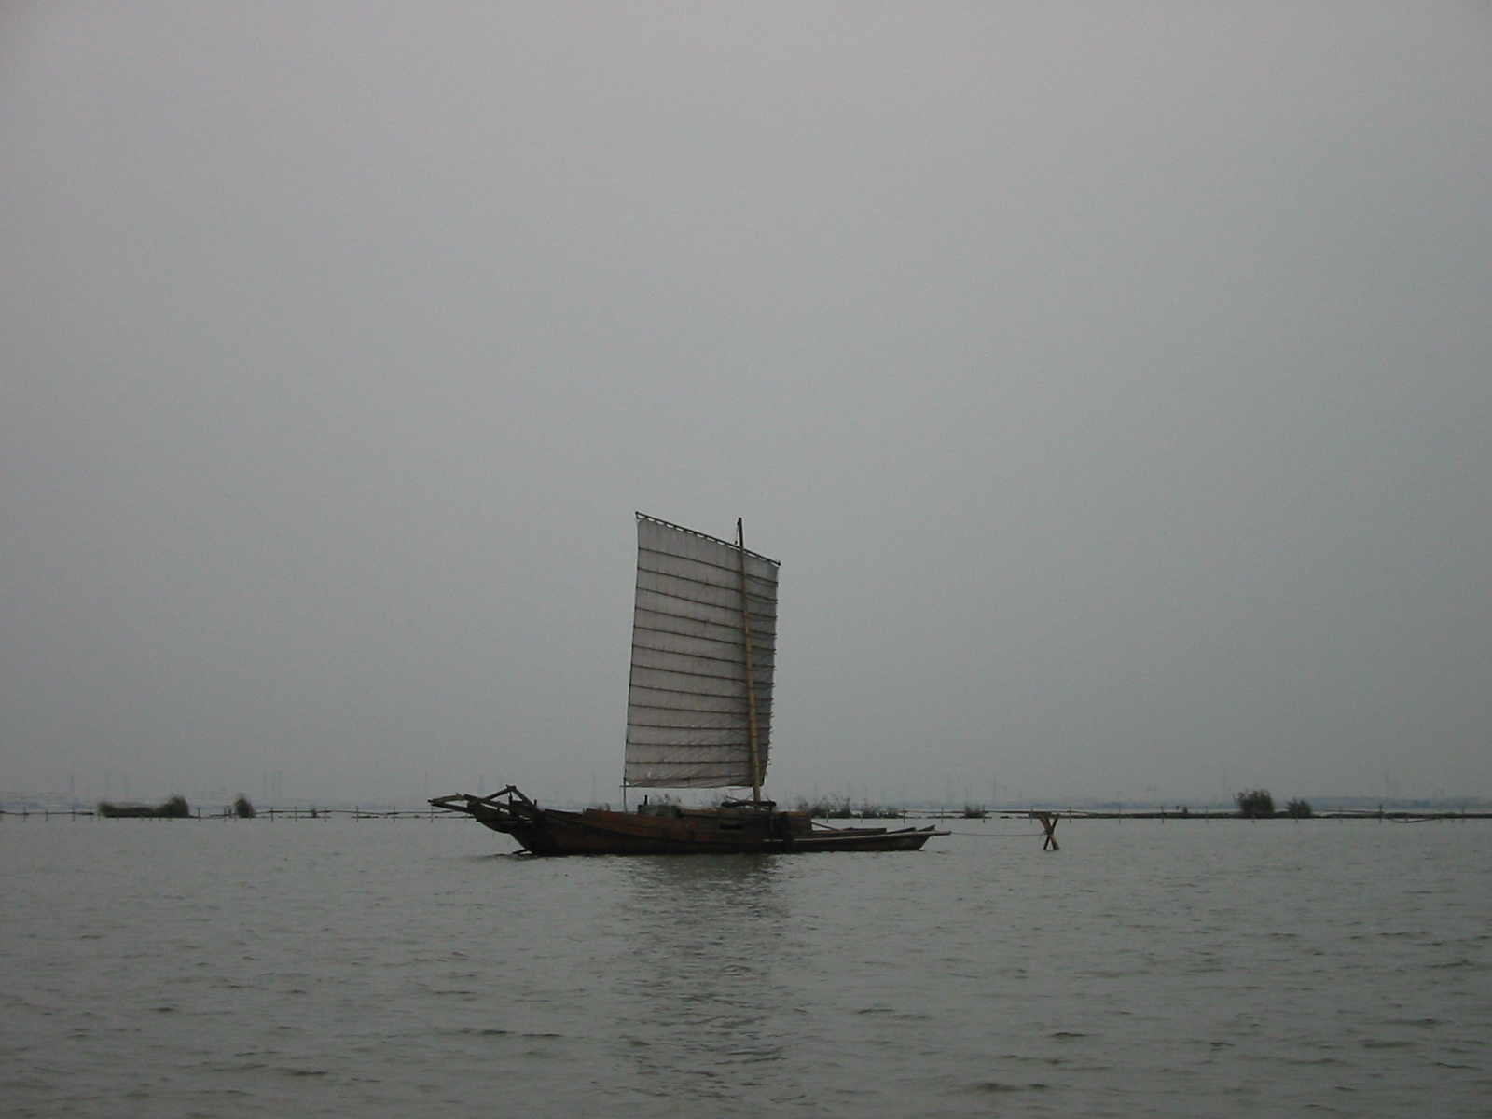
Beyond familiarity, we can genuinely live through our fresh roles including the things that don’t fit in from our natural ways…freely wandering to explore natural laws.
This exploration of wisdom involves pausing from both mind and actions for a moment known as, “Wu-Wei.” These states of non-action and non-doing involves re-syncing ourselves to move forward, both effortlessly and responsibly.
From here, authenticity further fine tunes the timing of our affairs just as the natural metronome from our own heart beat.

Slide 23

True wisdom does not seek permission from anything as we simply go astray, like free radical agents.
Through in both darkness and brightness, innocence will take us through a new intelligent control.
Remember the soul only yearns for play, love, and magic, and nothing else. Regardless of the awe and amusement, we still cling to none of it.

Slide 24

Awareness goes beyond coincidence because consciousness sees all life fall perfectly in place. Even with hidden incongruity colliding inside hidden predicaments, we can still honor the simple surfing moments.
Our over-inquisitive nature of trying to be over-human is often trapped to overdoing it, or over-thinking it in hopes to try to get it all right. Eventually from delight, we end up laughing through all the total absurdity.
As irreverent or reverent with trying to make sense to living life fittingly, it is really just a bag of twisted, spiritual, meaningless opportunities. Even all the steroids of spiritual illuminated principles joined by transformational distinctions somehow never lands if we are still being attached to all the meaning that’s said.
Notes:
3) Pause and slow down at last 2
4) Try Gibberish party's are nameless and formless conversations that freely unattached offers fresh clearing top feng shui the brain. Gibberish ;Next time when these heavy situations arise as constant patterns, try laughing? Through laughing, it holds life lighter as you unattached from the situation at hand and rise above it. Keep laughing at things whenever you feel they are dead serious. Nonsense of formless acts playful and safe. Etymology of words loose energy charge to language

Slide 25
Besides, we really do not have time to ask too many silly questions about life.
We may have numerous inquiries of exhaustive intellectual conversations whether the chick or the egg arrived first or, we can eventually say really that it all comes from nothing.
The universe has no origin, start or end, yet the circumference of consciousness forms everywhere.
Consciousness parallels to the immortal soul as everlasting states. We are part of this universe and at times feel timelessness in having these imperishable experiences. consciousness.
Notes:
2) Physicist can not seem to ever find the smallest particles or the largest form of space. The micro infinity and the macro infinity levels have no limits yet science keeps dividing as if its going somewhere. But never reaches the limits.
3) Science wont argue with us when having a soulful experience-all is sound from spirit

Slide 26
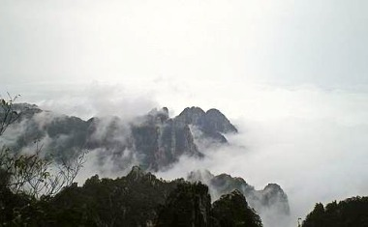
There may be no wisdom manual other than the intrinsic compass living already within you. Even if you can not trust all of life's contradictions, one can allow the seamless knowledge to spill through you to harnessed fresh wisdom.
Most effectively, getting out of our own way unlocks the ego and allows the ensemble of thoughts play to rest, relaxing into an eternal transcendent stream. Yielding to this new wisdom generates within the heart and soul of Tao.
As we uncloak ourselves, transparent awareness reveals Life truly for what it is.
Notes:
2) We can celebrate life without waiting to being totally polished, because fun mostly occurs during our polishing moments.
As far as polishing moments verses unpolished is really a state of mind that life is in constant change without fixing . not to be confused its therapy to get better we can keep our innocence as the balance and change of weather. Weather doesn’t argue or judge itself what it is doing in the moment, it is always seeking balance yet never finds total balance. We too are like weather where we get to trust the process with out us getting in the way of thinking it through.

Slide 27
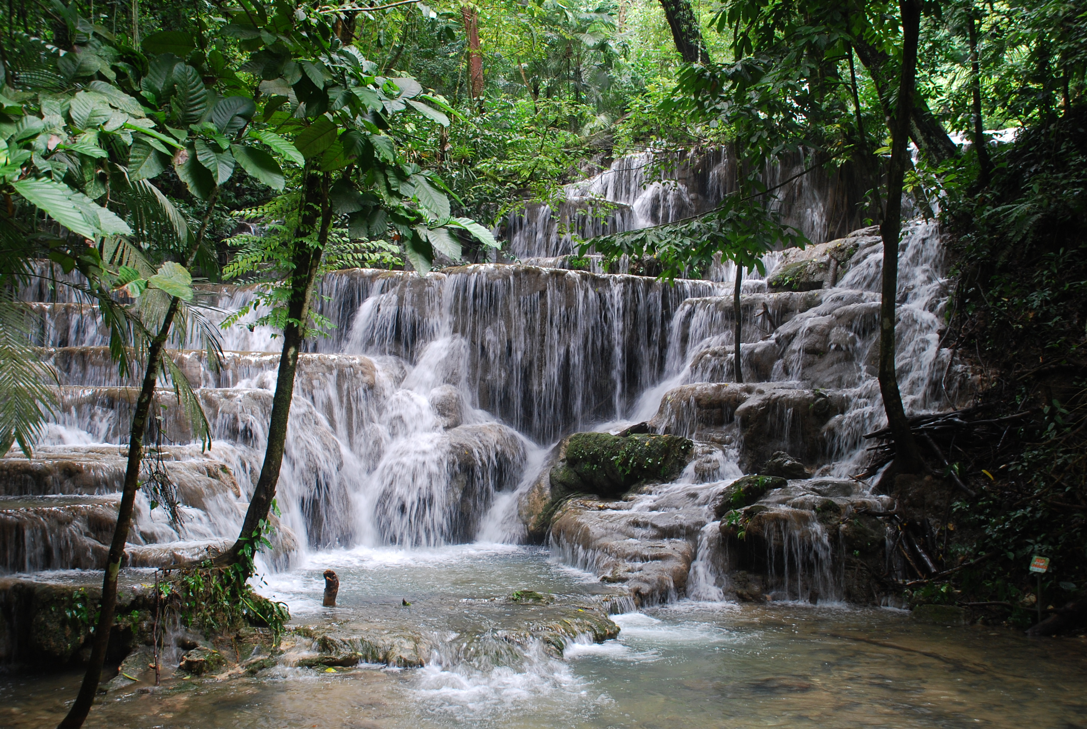
In the path of Tao, welcome new realms beyond ever seen or knew. From the formless, we invite all consciousness into a pool of flowing naturalness.
In these natural states, not only does wisdom flows intrinsically abundant, we also get to grant the awe of “being.”
Life is purely untouched just the way it always needs to be, as we have finally arrived, embraced by all its excellence, the Tao.
Notes:
see how much time we have –END OPTION before questions ahead

Slide 28
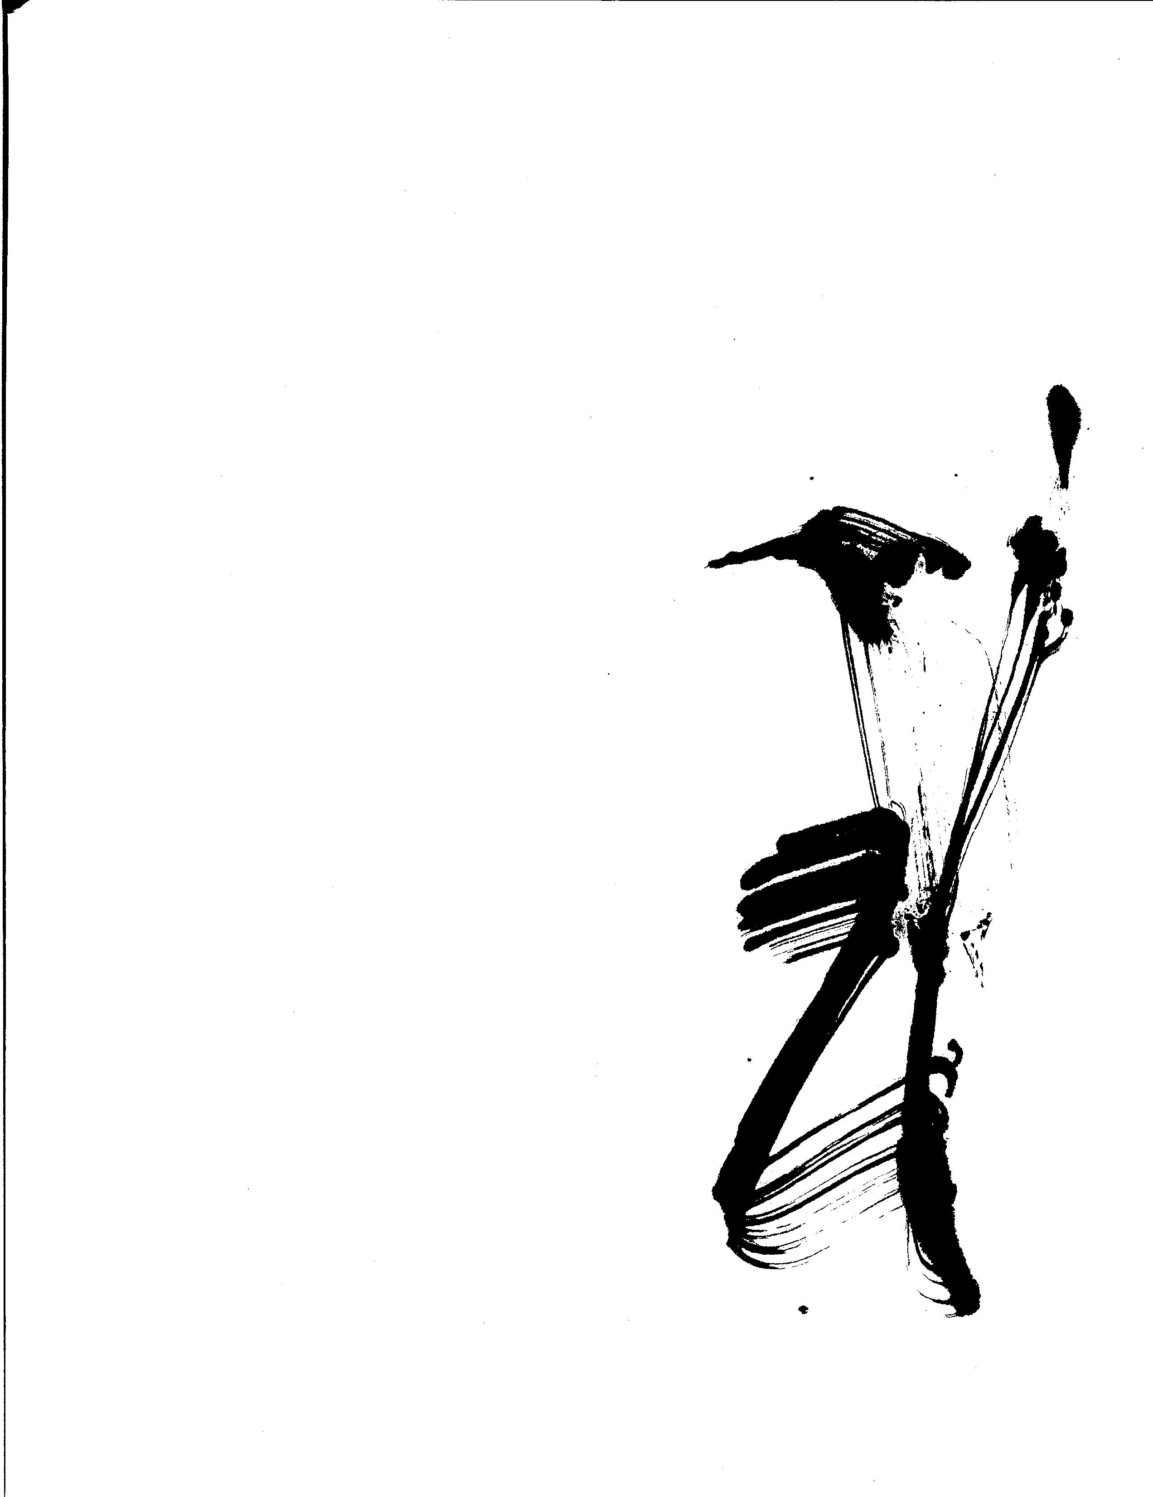
Sourcing Wisdom
Consider the heart a direct route to sustain our own nature. Notice if you land into the ease of heart or do you work the longest route from your mind during your active day?
If you are asking what this question means, then it is the mind at work, and if not, then you are likely having serendipity of heartfelt magic.
Keep noticing by simply navigating through your experience and observe if you are at freedom or not?
Notes:
Be with audience and let then respond slowly top each one

Slide 29
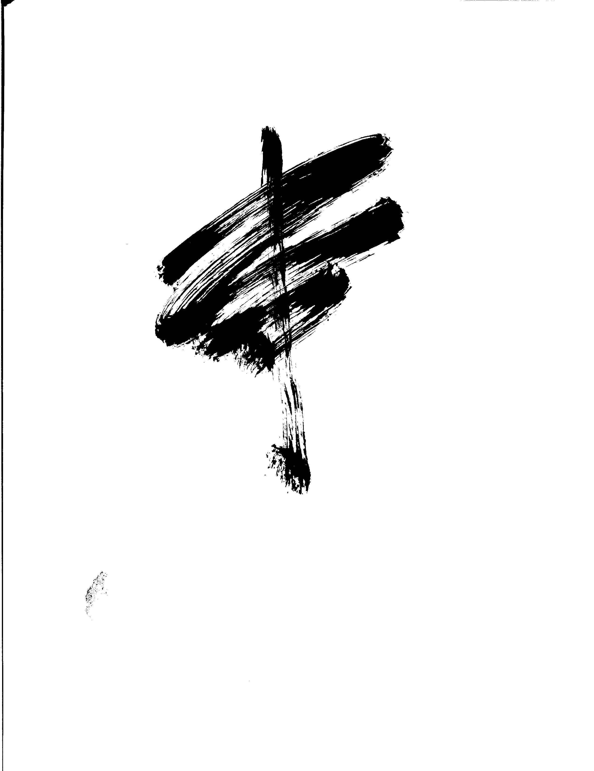
Direction to Tao’s Path
Have you ever made plans heading in one direction, yet comfortably finding yourself going somewhere else?
Give some examples from before where it actually worked to your true advantage of forming these great surprises.
After seeing this vision, can you welcome more surprises and relish risk? Continue to raise your stakes by setting yourself apart and follow a new edge that speaks to you.
Notes:
do in diode with partner: Were there any goals you followed through in resulting hitting dead end? Where did you think the path of your chosen goal would lead you and where did you actually end up? Can you identify these offset goals as blessings in despite there being a sense of chaotic uncertainty?

Slide 30
Paradigm Opening Into Tao
Our internal language builds a reality so that when we continue with what we say, paradigms never change.
Our mind filters like a search engine as well. Notice when you search key words on the internet such as “optimism” or “skepticism” on any subject how you will immediately find both subjects equally contested.
Notice the mind also searches evidence to find whatever it wants to justify as truth and secure being right about something. On this note, let's alter your paradigm that has previously run you obsolete. So, if you really want to change direction to serve a clearer power of intentions, what specifically might that be?
Notes:
what works and what doesn’t work

Slide 31
During this week, take Tao’s Wisdom out there
Start being the creation of your thoughts rather them designing you. Look what mostly inspires you? What creations enthuse you the most with your possibilities?
Every day, pick a new activity to play larger than yesterday’s game. Simply let your natural instincts guide and cue you through the next moment so every day becomes fully charged.
Keep the traction alive each day by taking on these new things continually. (Remember staying curious leaves the aperture wide open to invent new possibilities; otherwise, mediocrity will kill all the expressive energy of what’s idling inside).
Notes:
Slowly be with audience and let then respond
For accountability, set dates, schedules and accountably partners to keep you on tract

Slide 32
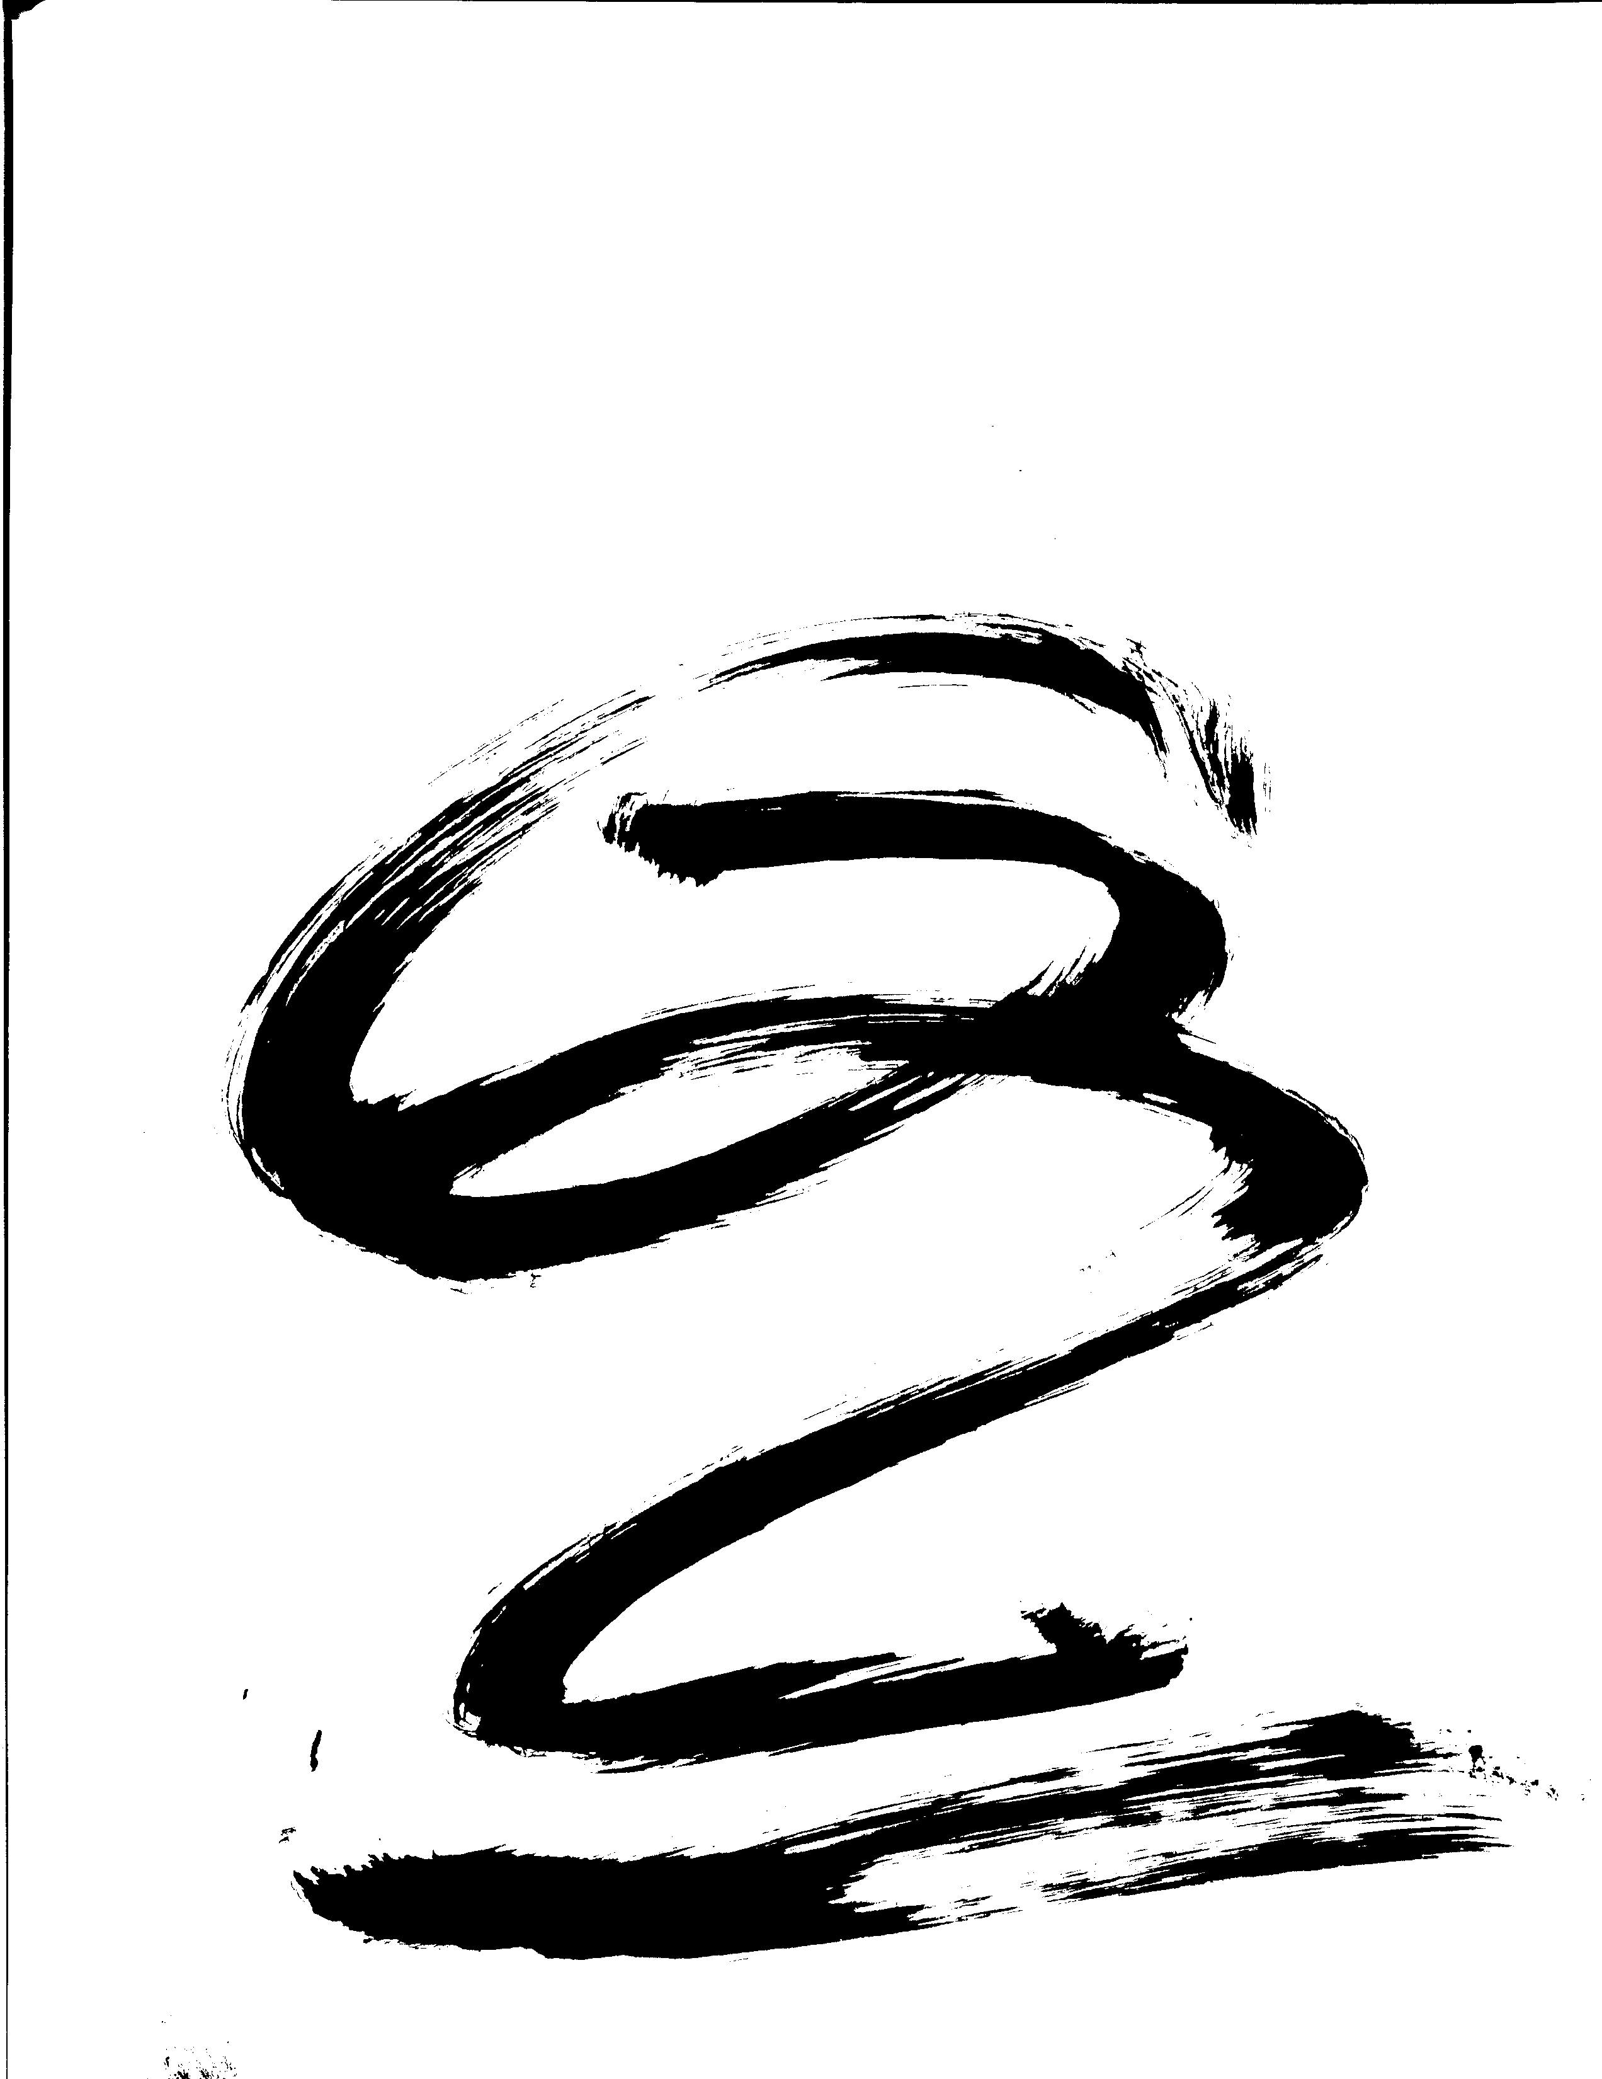
Embracing Change with Thought
What changes can you make in power with yourself so change happens internally rather than externally? Remember with change we work with what we’ve got so to move with where we’re going.
Let's move on beyond the mystery about resistance with change and ask what can you give up that’s wrong about change itself?
Looking at all the leftovers about complaints of change, pick an example about change you still don’t like and write it down for further clearing.
What can you choose from a new attitude that makes change an opportunity rather than a complaint?
Notes:
When I complain. My close friends and love ones remind you when I complain because we usually don’t notice it

Slide 33
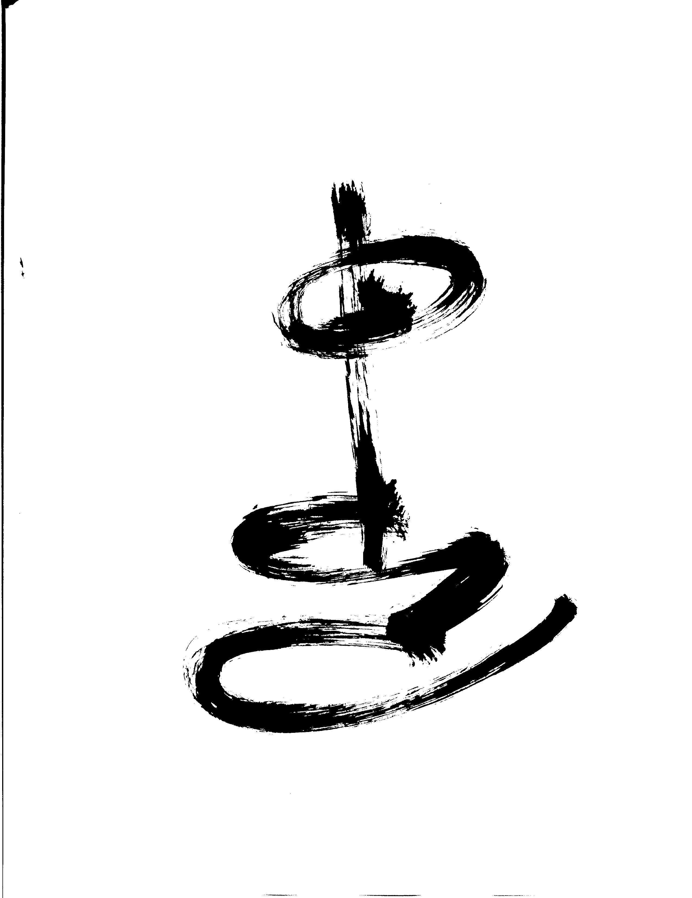
ExerciseOutside this Lecture:
Having fun can be unreasonable and sometimes outrageous. Find something that lands with you innovatively as a compassionate mix of released excitement.
Find something fun to do by giving up your inflexible plans that breaks out of your current ways.
Start creating some trouble and mischief through use of play. Don’t make any sense with this work; simply do something that is unfamiliar for you and make sure it’s unreasonably fun in your action plan. Start with activities with something you’ve never done that is totally unexpectedly unreasonable.
Once you’ve got it down, expand the game of further fun by planning ahead for longer retreats and even making reservations outside your typical environment.
Notes:
Be with audience and let them respond

Slide 34
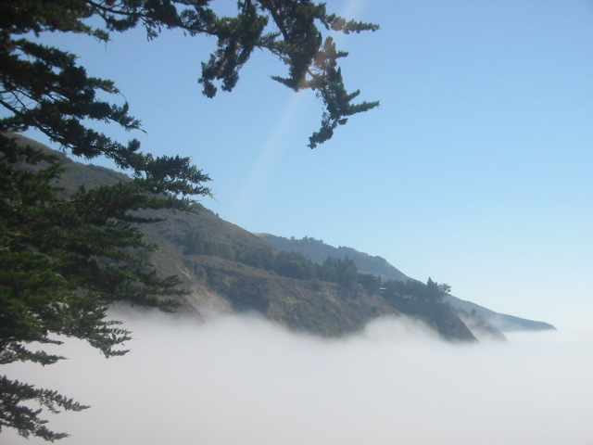
live
Tao
Notes:
Be with audience and let them respond by asking them what they learned, highlights or any takeaways
If I offended anyone with inaccuracies or stung anyone with words to come forward with my apologies

